Slide 1

HI6050 Capstone: Comprehensive Topic Selection and Supplementary Document
Supervisor: Dr. Farshid Keivanian
Session 6: Preparation for Group Final Report

Slide 2
Session 6’s outline
1. Weekly Task Breakdown & Milestones
2. Preparation for Group Final Report
3. Group Progress Presentation – Overview of Progress at least 2 min

Slide 3
Weekly Task Breakdown & Milestones
Week | Action
Week 1-2 | Form groups, confirm your campus group number, select topic via Blackboard sheet.
Week 3 | Begin literature review + define project scope and research question.
Week 4 | Finalize tools, datasets, programming language; create basic prototypes/mockups.
Week 5 | Draft your research proposal + submit it.
Week 6 | Submit Research Proposal (25%)
Week 7-10 | Start project build (coding/analysis), write sections of final report.
Week 11 | Submit Final Report (45%)
Week 12 | Present & Demo Project (30%)

Slide 4
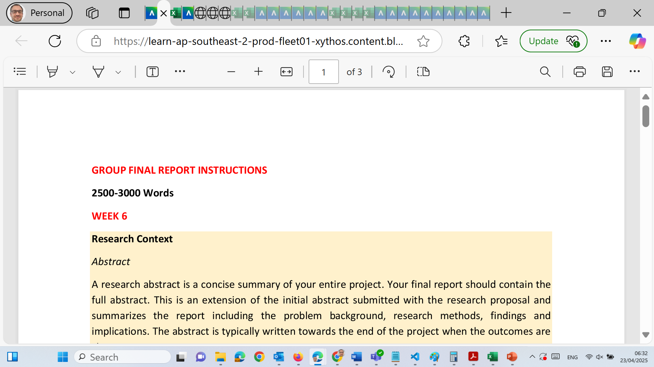
Preparation for Group Final Report

Slide 5
Preparation for Group Final Report
Word Count: 2500–3000 words Format: Microsoft Word (.docx only) | Holmes Harvard Referencing Submission Method: Blackboard (desktop/laptop only) Penalty: ❌ Students not listed on the cover sheet will receive zero marks

Slide 6
Preparation for Group Final Report
Purpose of the Report
The Group Final Report is a cumulative submission representing the research work, findings, and implications from your semester-long investigation. It showcases your ability to:
Frame a research problem
Conduct a literature-based inquiry
Present meaningful findings and recommendation

Slide 7
Preparation for Group Final Report
Weekly Breakdown – Section-by-Section Guide
WEEK 6 – Research Context
1. Abstract (100–250 words)
A concise summary of the whole report.
Include: the research problem, methods, major findings, and implications.
Tip: Write it last, but place it at the beginning.

Slide 8
Preparation for Group Final Report
2. Introduction
Include the following:
Background to the research area
Clear description of the problem
Significance of the research
Research question(s)
Project scope and limitations
Ethical considerations
Chosen research approach (qualitative – literature review)

Slide 9
Preparation for Group Final Report
WEEK 7 – Research Methods
3. Methodology
Use a qualitative approach (systematic literature review).
Follow guidance from Okoli & Schabram (2010).
Clearly describe:
What sources were searched?
What keywords or criteria were used?
Why was a literature review selected?
How was bias minimized?

Slide 10
Preparation for Group Final Report
WEEK 8 – Literature Review
4. Literature Review
Provide scholarly background to your topic.
Use relevant, peer-reviewed sources (journals, white papers, reports).
The review should:
Highlight existing gaps
Compare prior findings
Serve as evidence for your research direction
Reference:
Okoli & Schabram (2010), “A Guide to Conducting a Systematic Literature Review…”

Slide 11
Preparation for Group Final Report
WEEK 10 – Research Results & Conclusion
5. Results
Objectively present your findings from the literature.
Avoid interpretation or bias – just present the data/patterns/themes.

Slide 12
Preparation for Group Final Report
6. Discussion & Conclusion
In this section:
Interpret findings
Reflect on their significance
Compare to existing knowledge
Suggest improvements or policy/industry relevance
Offer future research directions

Slide 13
Preparation for Group Final Report
WEEK 11 – Final Report Submission
7. References
Use Holmes Adapted Harvard Style
Minimum of 10 scholarly sources recommended
All in-text citations must match the reference list

Slide 14
Preparation for Group Final Report
Final Document Includes:
Title Page + Cover Sheet (all team members listed)
Abstract
Introduction
Methodology
Literature Review
Results
Discussion & Conclusion
References

Slide 15
Preparation for Group Final Report
Formatting Requirements
MS Word (.docx) ONLY
Font: Calibri, size 11pt, no spacing
Margins: 2 cm on all sides
All group members must be listed on the cover sheet
Submit from desktop/laptop (no phones/tablets/Blackboard app)

Slide 16
Preparation for Group Final Report
What Will Be Rejected (Zero Mark & Academic Misconduct)
❌ No cover sheet ❌ Students not registered in your Blackboard group ❌ PDF, Pages, screenshots, or handwritten answers ❌ Submitting from smartphones ❌ Listing students who did not contribute ❌ AI-generated text without critical editing or citation ❌ Submissions from overseas IPs without permission

Slide 17
Preparation for Group Final Report
Tips for Success
Start Early: Break down the work into manageable chunks weekly.
Assign Roles: Research lead, editor, reference checker, Gantt chart creator.
Use a Literature Matrix: To track your readings.
Use Tools: Zotero, Mendeley, or EndNote for referencing.
Proofread Carefully: Spelling, flow, and formatting affect marks.
Book Drop-in Consultations: For feedback or clarification.

Slide 18
Preparation for Group Final Report
Submission Checklist
Abstract summarizes full research
Introduction outlines scope, problem, and approach
Methodology uses systematic literature review
Literature review uses 10+ scholarly sources
Results presented objectively
Discussion interprets findings in context
All citations are correct and listed in references
Final .docx submitted via Blackboard from PC/Mac
All team members listed on cover sheet

Slide 19
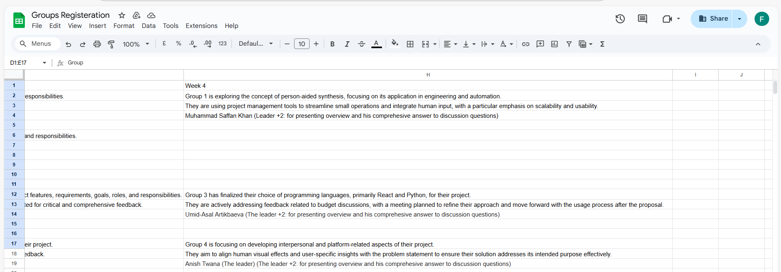
Group Progress Presentation – Overview of Progress at least 2 min

Slide 20
Thank You
Need Help? Send an email or ask during the tutorial session.
Good luck with your capstone journey!
Dr. Farshid Keivanian Capstone Project Supervisor farshid.keivanian@holmes.edu.au

